Slide 1





RuxaiLab
Sentiment Analysis for
Usability Tests
GSoC 2024
Meet #2: Project Proposal Overview
Presented By: Olivia Wilson
09-06-2024 17:00 (UTC+3)

Slide 2


Agenda
Who am I
Problem
Dataset
Approach
Integration to Ruxailab
Tools
Video Sentiment Analysis
Timeline

Slide 3





Who am I
Basma Elhoseny
4th year Computer Engineering Student @ CUFE
Start my MSc next semester
Computer Vision Course TA 2024-2025 @ CUFE
Interested In:
Natural Language Processing
Computer Vision
Neural Networks
Machine Learning

Slide 4




Problem
Problems:
A lot of Answers need to be reviewed
Statistics can’t be extracted from raw textual Answers
Solution
Semantically Analyze Answers

Slide 5

Dataset
We don’t have Data Set for this Task :(
2 Options
Big Challenge

Slide 6
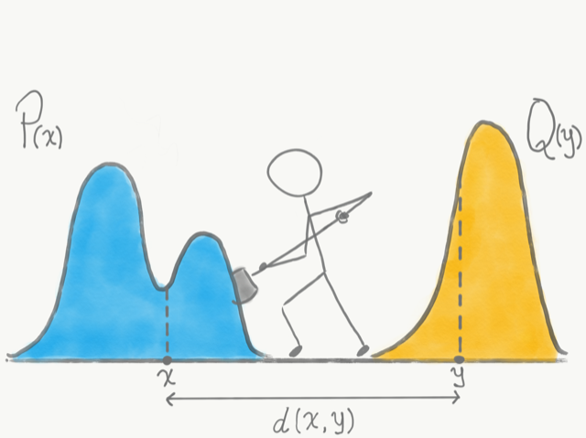
Dataset
Similar Data for apps reviews

Slide 7
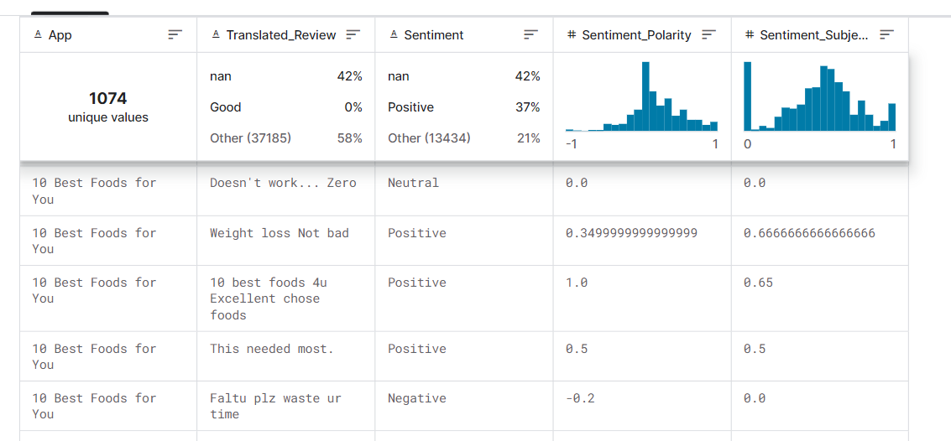

Dataset
Google Play Store Apps Review
64K Reviews 🡪 9659 different apps
Labels: Positive - Negative - Neutral
Data source here

Slide 8
Dataset
ChatGPT App Review
Extra Google Play Review with ratings

Slide 9
Dataset
Google Play Store Apps Review
64K Reviews 🡪 9659 different apps
Labels: Positive - Negative - Neutral
Data source here

Slide 10
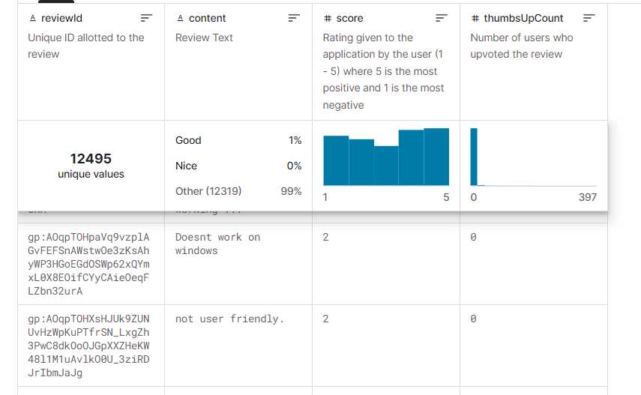
Dataset
Extra Google Play Review with ratings
12000 reviews of different app store applications by real use
Labels: Rating 1-5
Data source here

Slide 11
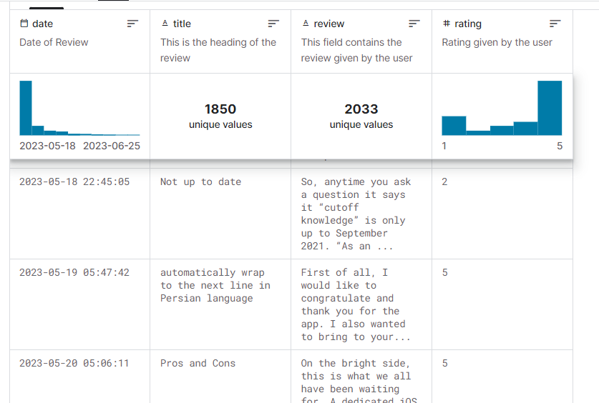
Dataset
ChatGPT App Review
Reviews for ChatGPT application.
2033 users’ reviews Ratings 1-5
Data source here

Slide 12
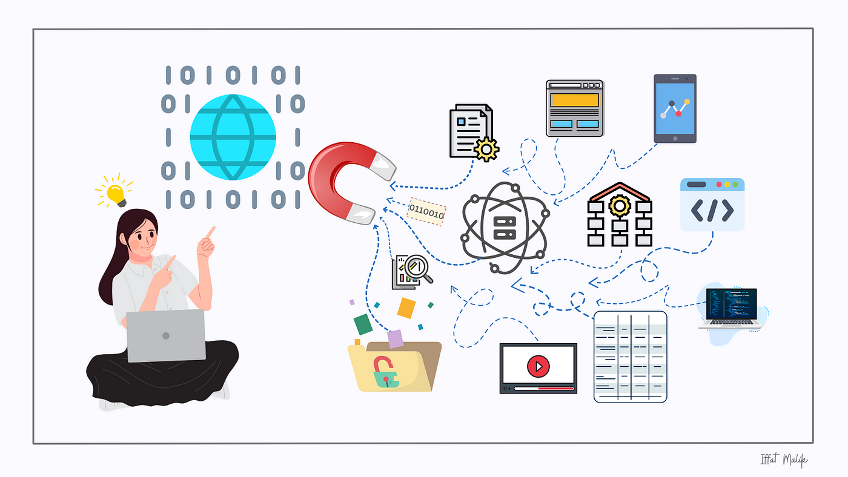
Dataset
Real System Data + Some Augmentation

Slide 13
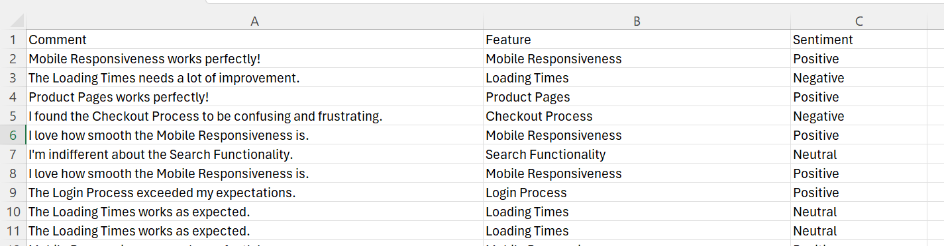
Dataset
System Trial !!

Slide 14


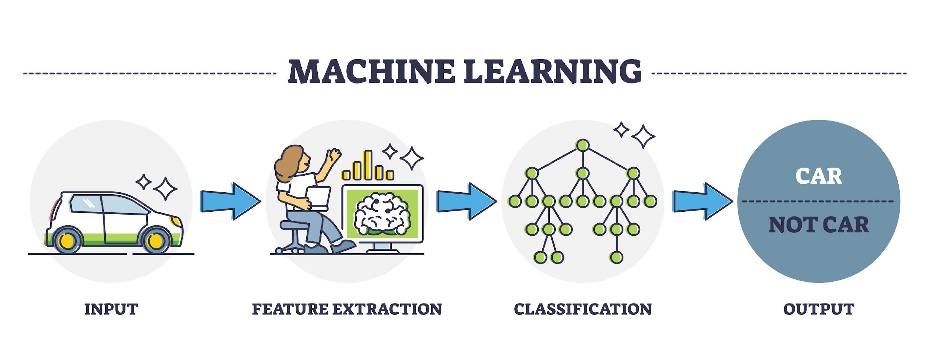
Approach
+

Slide 15
Approach
Problems:
A lot of Answers need to be reviewed
Statistics can’t be extracted from raw textual Answers

Slide 16
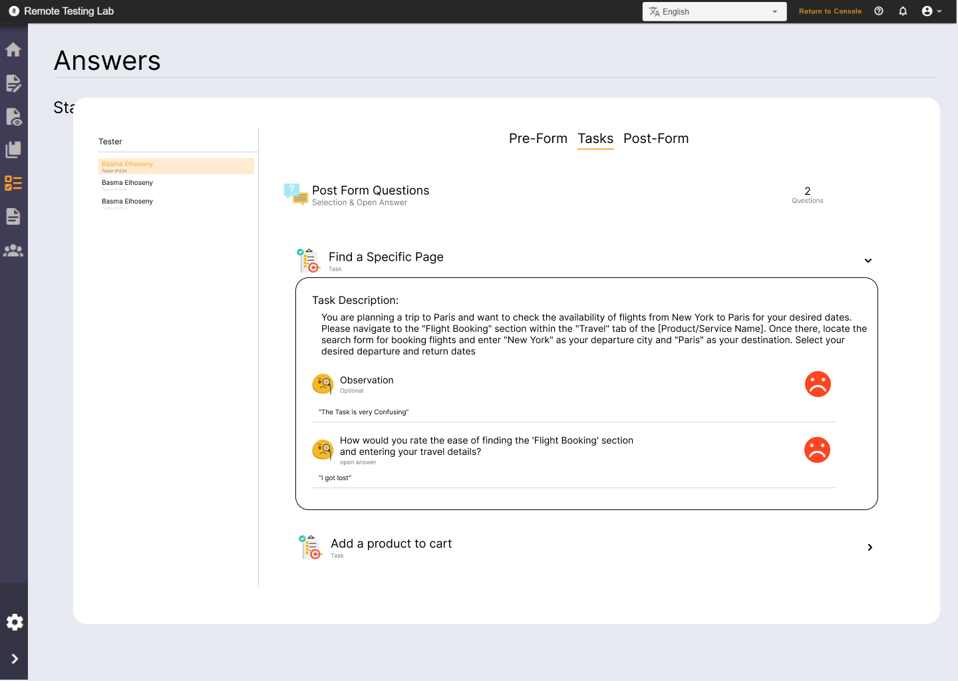
Integration to Ruxailab
Sentiment Analysis for:
Open Answer Questions
Optional Opinion Questions

Slide 17



Integration to Ruxailab
No Sentiment Analysis for:
Selection Questions

Slide 18
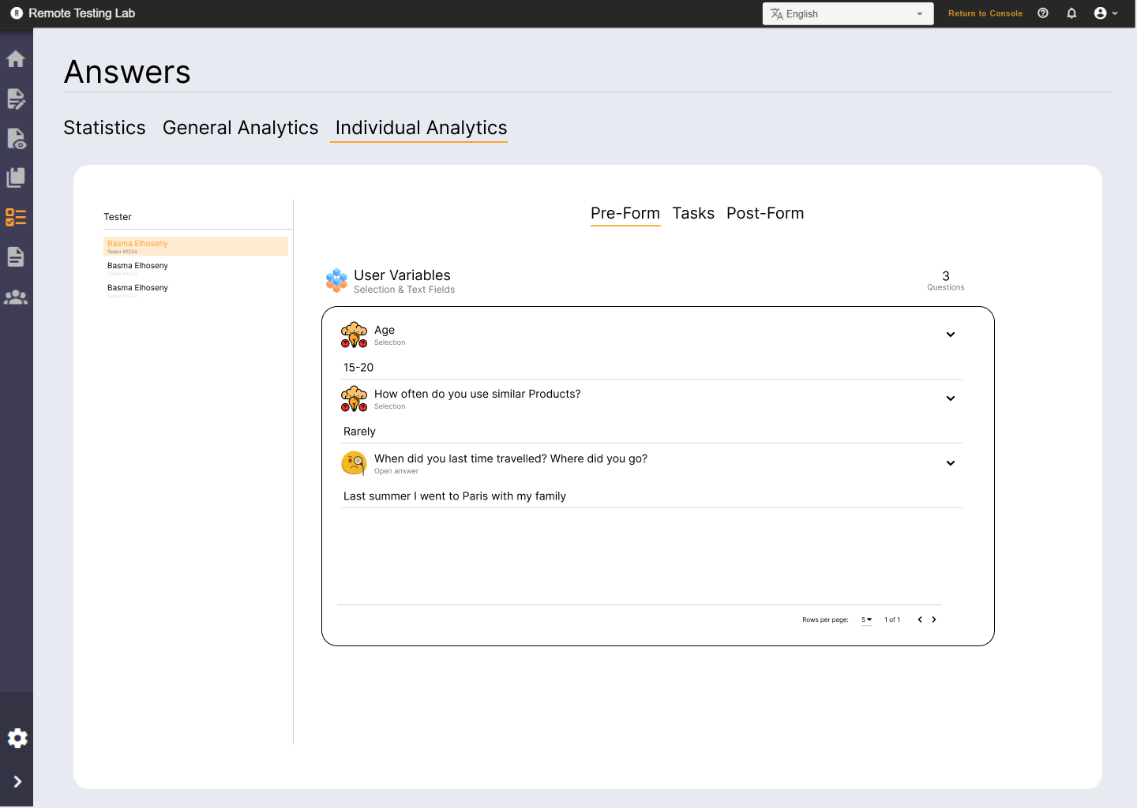
Integration to Ruxailab
(Individual)
Figma Screens here

Slide 19
Integration to Ruxailab
(Individual)
Sentiment of
the answers
Figma Screens here

Slide 20
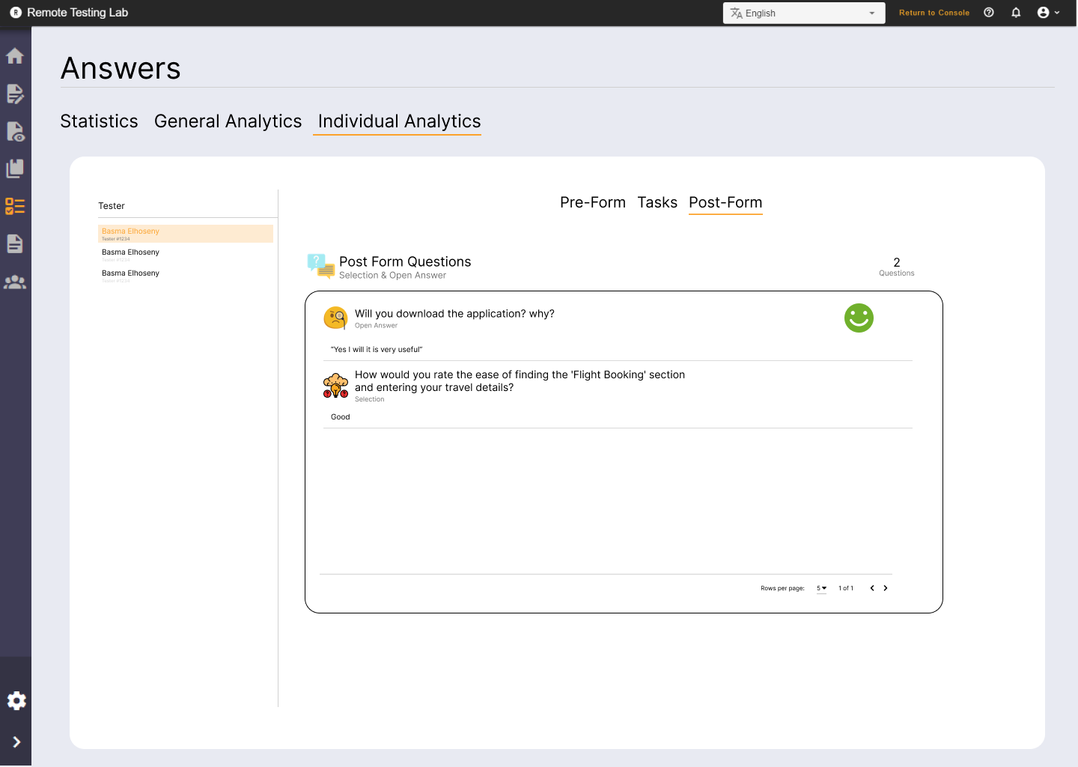
Integration to Ruxailab
(Individual)
Sentiment of
the answers
Figma Screens here

Slide 21
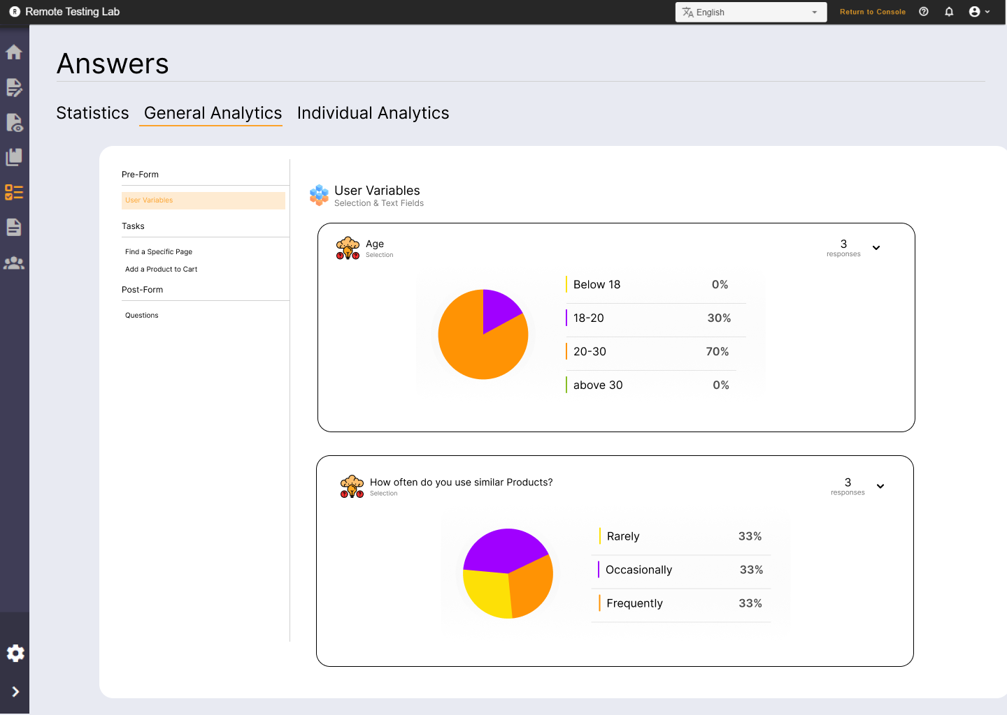
Integration to Ruxailab
(General)
Statistics for selection Questions
Figma Screens here

Slide 22
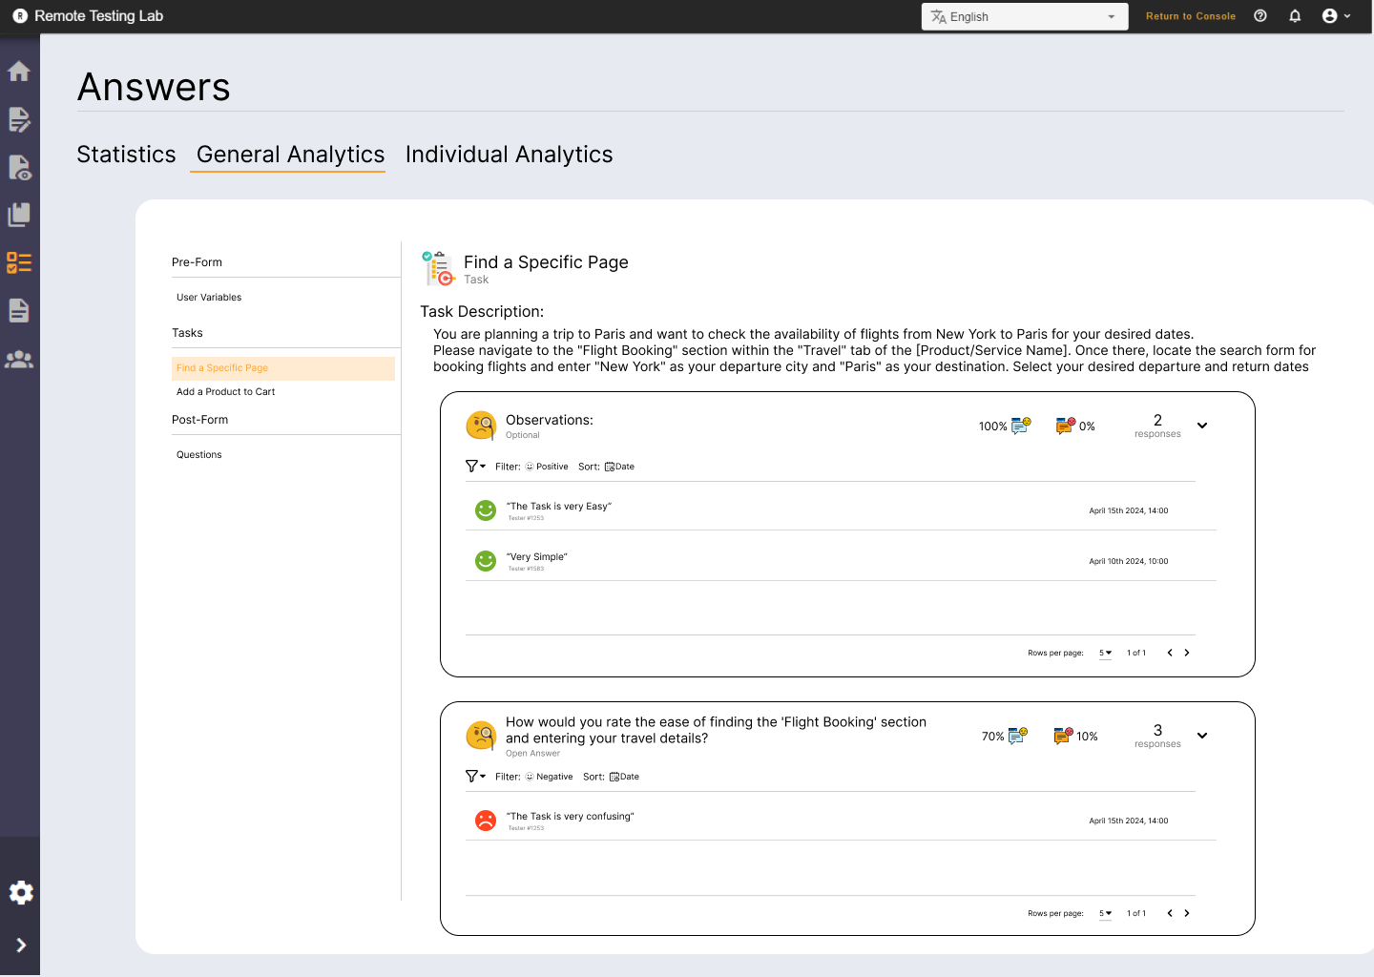
Integration to Ruxailab
(General)
Sentiment of
the answers per Question
Figma Screens here

Slide 23
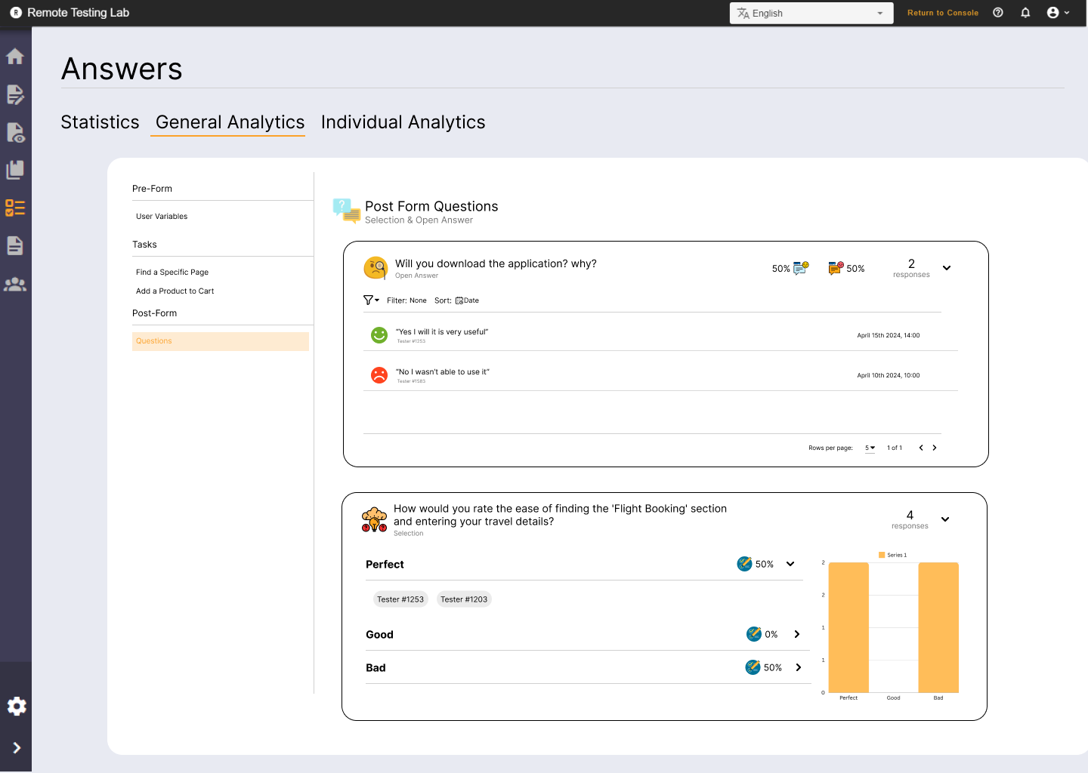
Integration to Ruxailab
(General)
Sentiment of
the answers per Question
Figma Screens here

Slide 24






Tools
Pytorch
Hugging Face (Check Later)
TensorBoard
VueJS
Streamlit
Fast API
Deploy (Google Cloud) (Check Later)
Notes:
Check Alternatives for memory

Slide 25


Tools
I Need to Learn:
Hugging Face
Streamlit
Fast API
Deploy (Google Cloud)

Slide 26
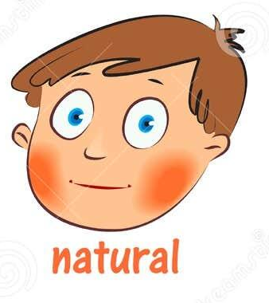
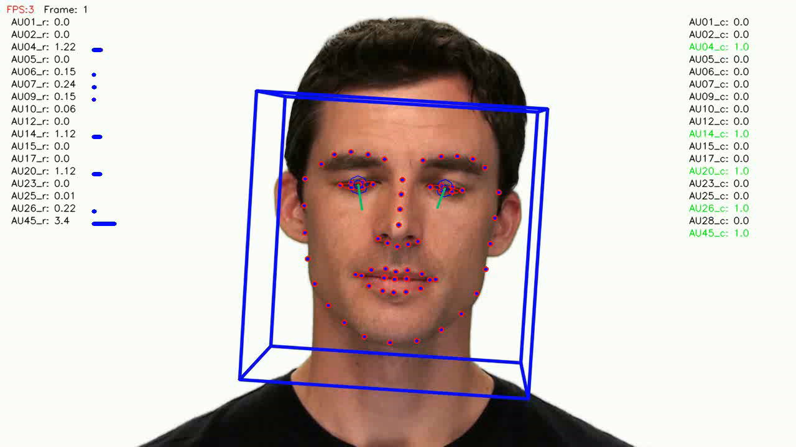
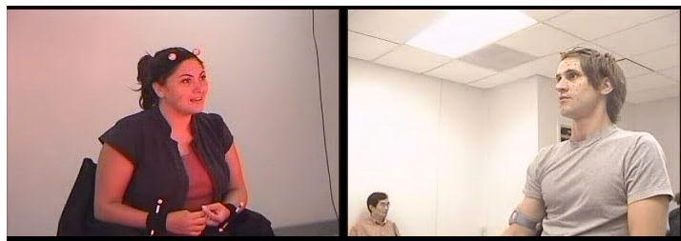
Video Sentiment Analysis
Data Sets Available:
IEMOCAP Dataset
Facial Tracking Dataset

Slide 27

Video Sentiment Analysis
We Will Focus on Textual Answers

Slide 28

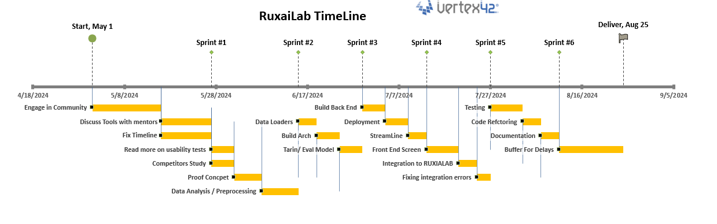
Timeline

Slide 29





Thank you
Any Questions?
BasmaElhoseny01
basmaelhoseny01
basmaelhoseny6@gmail.com
Notes:
Points To Check with Mentors:
1. Moderated/Un Moderated Tests

